Slide 1
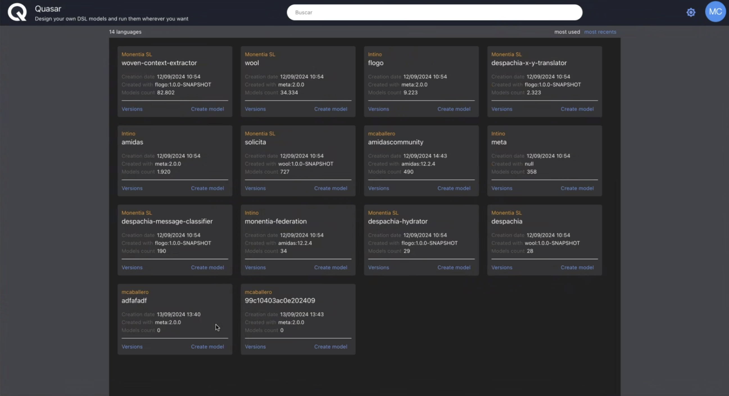

Slide 2

FLOGO 1.0 for modeling neural networks
Start modeling
view examples
type - operation - execution lambda function (docker image url) – icon

Slide 3

META 2.0
for creating modeling languages
Create language
view examples

Slide 4
TAFAT 2.0
for creating simulation languages
Create language
view examples

Slide 5


DSML FLOGO 1.0
Properties
Download
Build
Publish
powered by META 1.4

Slide 6
Download Properties
CITY LOGIC 1.1 DSML – TAFAT 2.0
Build
Publish

Slide 7
New version from this Download Properties
CITY LOGIC 1.1 ^{published} DSML – TAFAT 2.0

Slide 8
Download Properties
CITY LOGIC 1.2 DSML – TAFAT 2.0
Build
Publish

Slide 9

CITY LOGIC 1.1
for creating simulation models of cities
Start modeling
view examples
operation - execution web service

Slide 10
Karlsruhe MODEL - CITY LOGIC 1.1
Simulate
Add as example
Save
Download
Problems
Notes:
http://quasar.io/citylogic/1.1/karslruhe

Slide 11
Classifier MODEL – FLOGO 1.0
Build
Add as example
Save
Download
files
Notes:
http://quasar.io/citylogic/1.1/karslruhe

